Slide 1

SMART QUESTION
NGUYEN PHU LOC

Slide 2
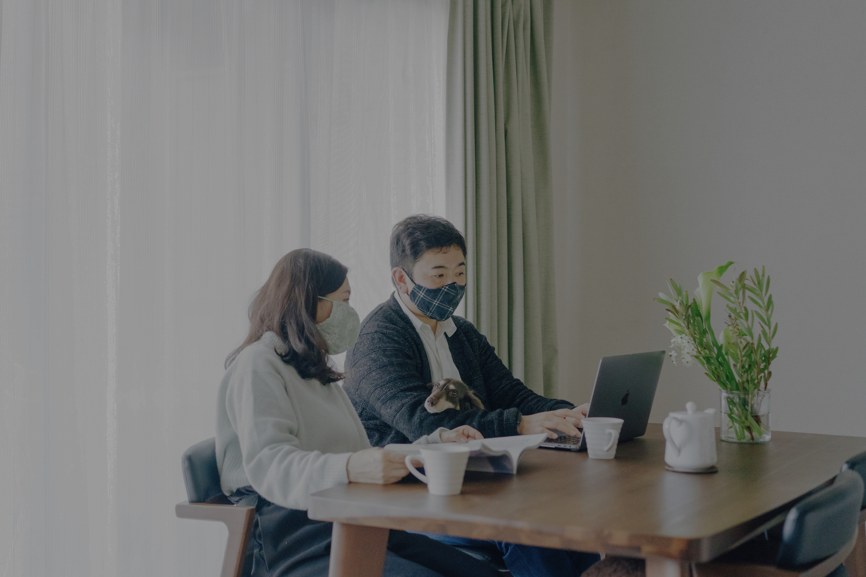
Part 1:
CONTENTS
Why is the smart question important?
Part 2:
How to ask a smart question.
Part 3:
The most common mistake in questioning.
Part 4:
Principles to evaluate the question.

Slide 3




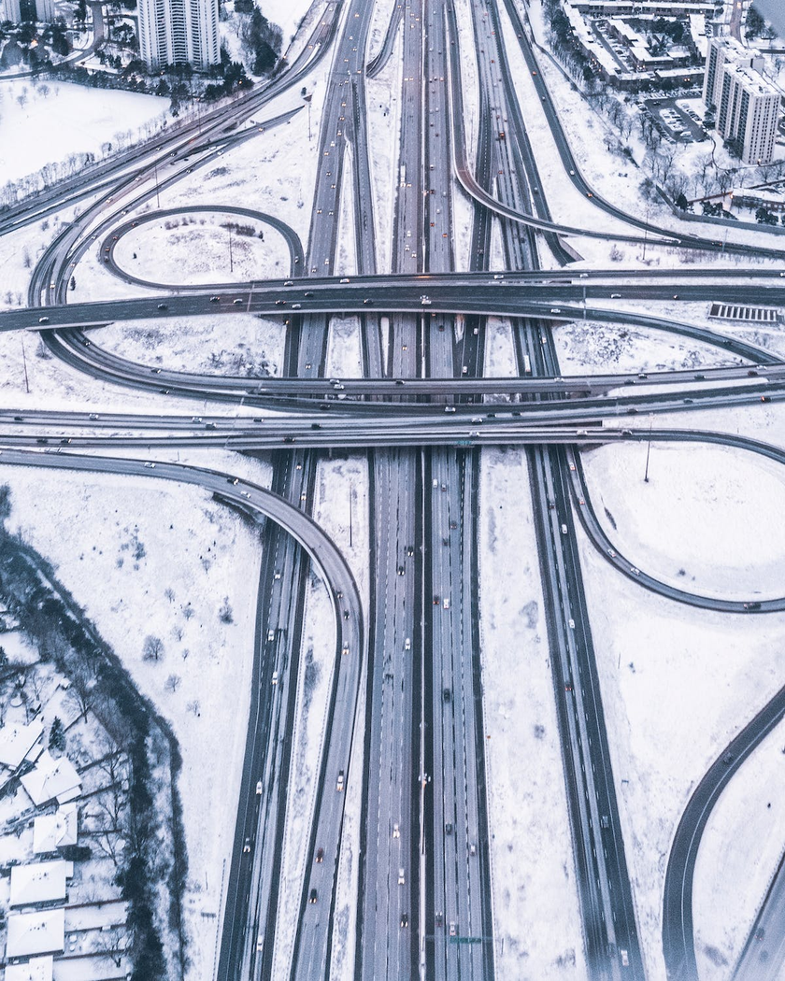
PART 1: WHY IS THE SMART QUESTION IMPORTANT?
Learning, improving
Effective
communication
Crictical
thinking
Problem
solving
Decision
making

Slide 4

LEARNING, IMPROVING
Deepen knowledge;
Reflect on events to gain self-awareness.

Slide 5
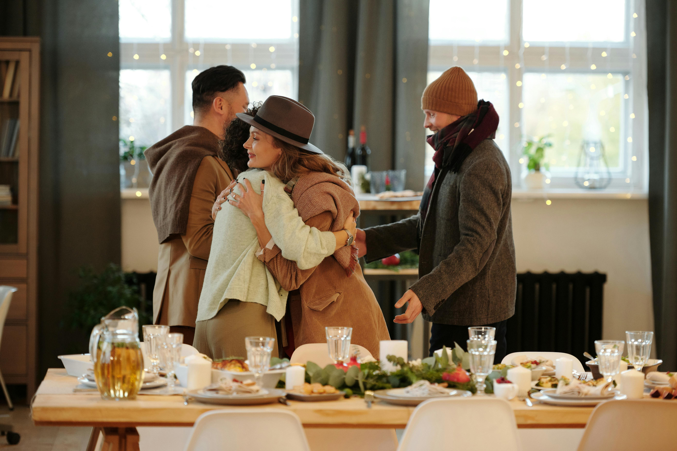
EFFECTIVE COMMUNICATION
Ask profound questions
Ask meaningful questions.

Slide 6

CRICTICAL THINKING
Engage in deep questioning
Pose multiple inquiries from different perspectives

Slide 7
PROBLEM SOLVING
Delve into the issue, uncover its root causes through insightful questioning.

Slide 8

DECISION MAKING
Deepen knowledge;
Reflect on events to gain self-awareness.

Slide 9

PART 2: HOW TO ASK A SMART QUESTION.
1.Think about what you already know
2. Confirm what you want to learn from the question
3. Stay open-ended question
4. Create a draft of your questions
5. Refine your questions
6. Ensure simplicity
7. Ask your questions confidently and politely

Slide 10
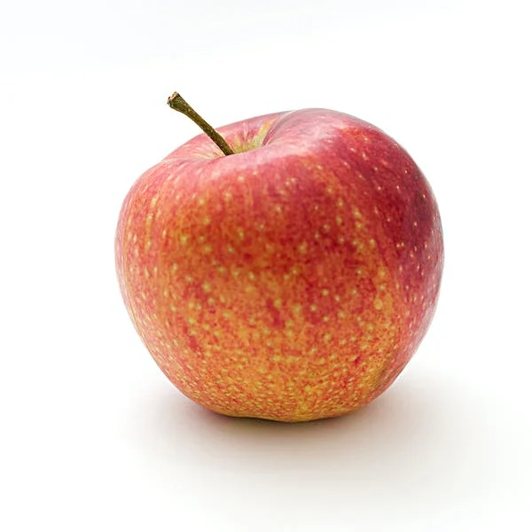
PART 2: HOW TO ASK A SMART QUESTION.
Ex: When you learn a new vocabulary

Slide 11
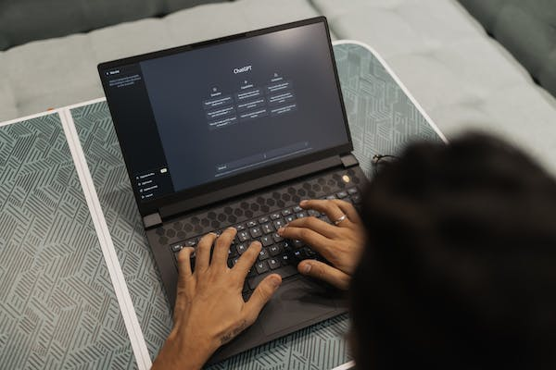
PART 2: HOW TO ASK A SMART QUESTION.
Ex: When you ask chatGPT to research some knowlegde

Slide 12

PART 4: PRINCIPLES TO EVALUATE THE QUESTION..

Slide 13

PART 3: THE MOST COMMON MISTAKES IN QUESTIONING.
Ask vague question
Ask many question at a time
Not paying attention when someone is answering
Don’t give the other enough time to think
Leave other person feeling useless
Use complicated or technical language

Slide 14

PART 4: PRINCIPLES TO EVALUATE THE QUESTION..
Does that question include a Metric & a Dimension?
Does that question refer to one circle, or more?
Does that question stand for the “So What” rule?
Does that question stand for the “What So” rule?
Is that question abstract, or focused?
Does that question lead to another question?
Is that a negative or a positive question?

Slide 15

THANK YOU
NGUYEN PHU LOC

